Slide 1
Industry Oriented Hands-on Experience
on
BookMyTailor
(Course Code: 22CS422)
Presented By:
Akshita Minhas(2211985004)
Saneha Bhatia (2211985044)
Suhani (2211985050)
Supervised By:
Dr. Rajat Takkar (CET1004342)
1

Slide 2





Sustainable Development Goals
Industry, Innovation, and Infrastructure (SDG 9)
Introduces digital transformation in traditional tailoring industry
Builds an online service infrastructure
Encourages innovation in local business models
Connects customers and service providers through technology
Sustainable Cities and Communities(SDG11)
Supports local businesses within communities
Reduces unnecessary travel through online booking
Promotes organized service systems in cities and towns
Strengthens community-based services

Slide 3
Introduction
In many regions, especially smaller cities and towns, customers face difficulty in finding skilled tailors and booking appointments at convenient times. Traditional tailoring services rely on walk-in visits or manual scheduling, leading to long waiting times and inefficient service management.
Our project aims to solve this problem by developing a digital platform (BookMyTailor) that allows users to easily find tailors, book appointments, and customize clothing services online. This system improves accessibility, saves time, and enhances the overall customer experience while supporting local tailoring businesses. It promotes smart service solutions, better time management, and strengthens the connection between customers and tailoring professionals.
Key Features :
Easy Appointment Booking
Tailor Discovery Platform
User-Friendly Interface
Customization & Order Management
Time-Saving and Efficient
Scalable System

Slide 4
Problem Statement & Need Statement
Problem Statement:
Traditional tailoring services often rely on walk-in visits and manual appointment scheduling, leading to long waiting times, poor time management, and lack of convenience for customers. Many people find it difficult to locate skilled tailors nearby or check their availability in advance.
Additionally, there is no centralized platform that connects customers with tailors, which limits business opportunities for local tailors, especially in small towns and low-resource areas. This results in inefficient service delivery and reduced customer satisfaction.
Need Statement:
This solution aims to simplify the process of finding and booking tailoring services through a digital platform. It will improve accessibility for customers, save time, and provide a more organized system for managing appointments and orders.
BookMyTailor will support local tailoring businesses by giving them an online presence, increasing their reach and income opportunities. It will also promote efficient service management, reduce delays, and enhance customer experience.
Overall, the system will create a more convenient, scalable, and sustainable solution for both customers and tailoring professionals.

Slide 5
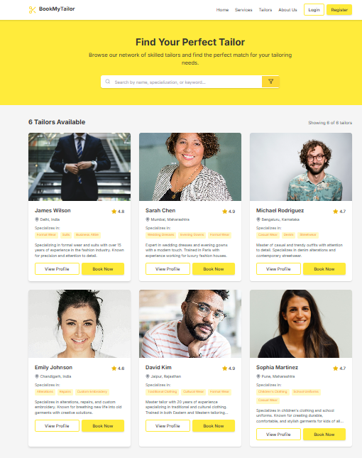
Web Design

Slide 6
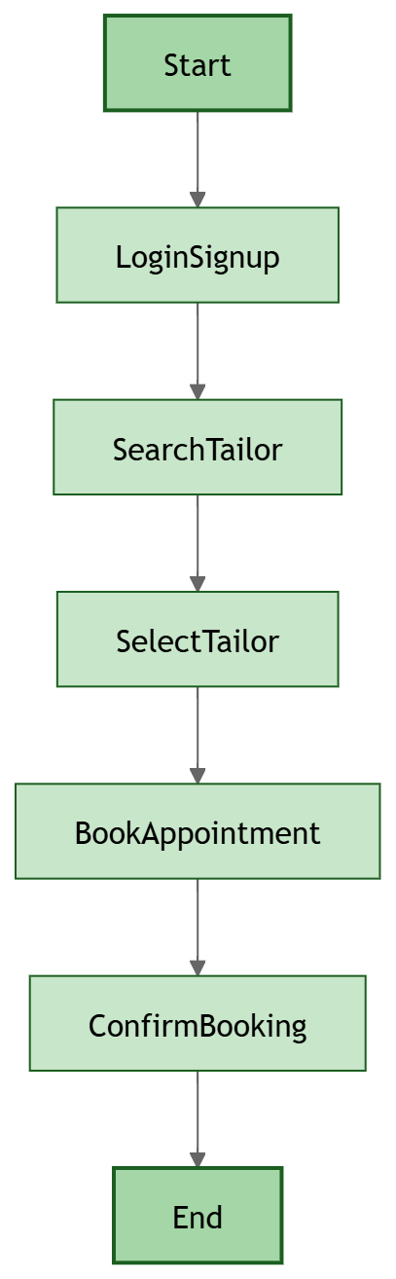
Activity Diagram

Slide 7
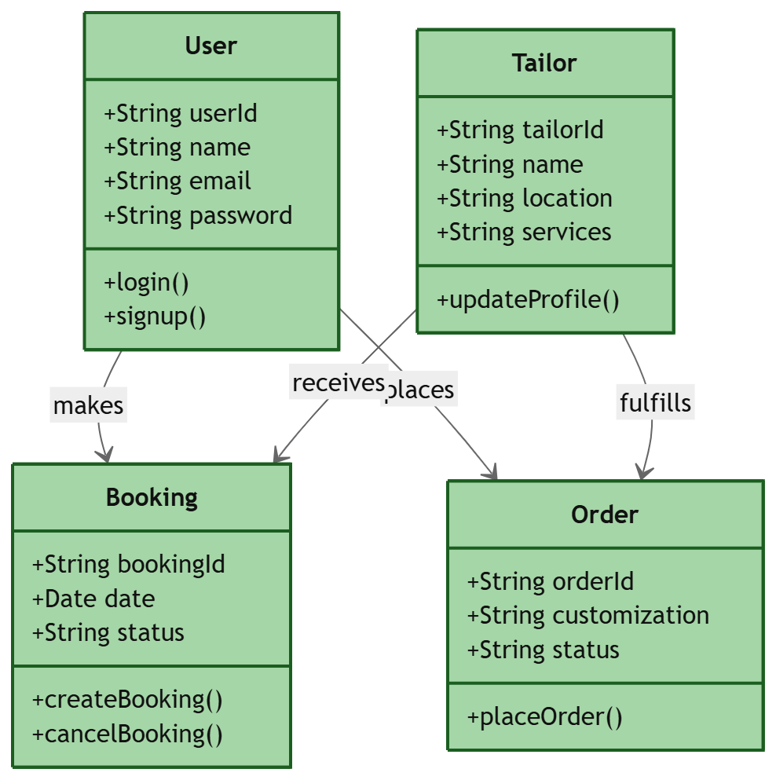
Class Diagram

Slide 8
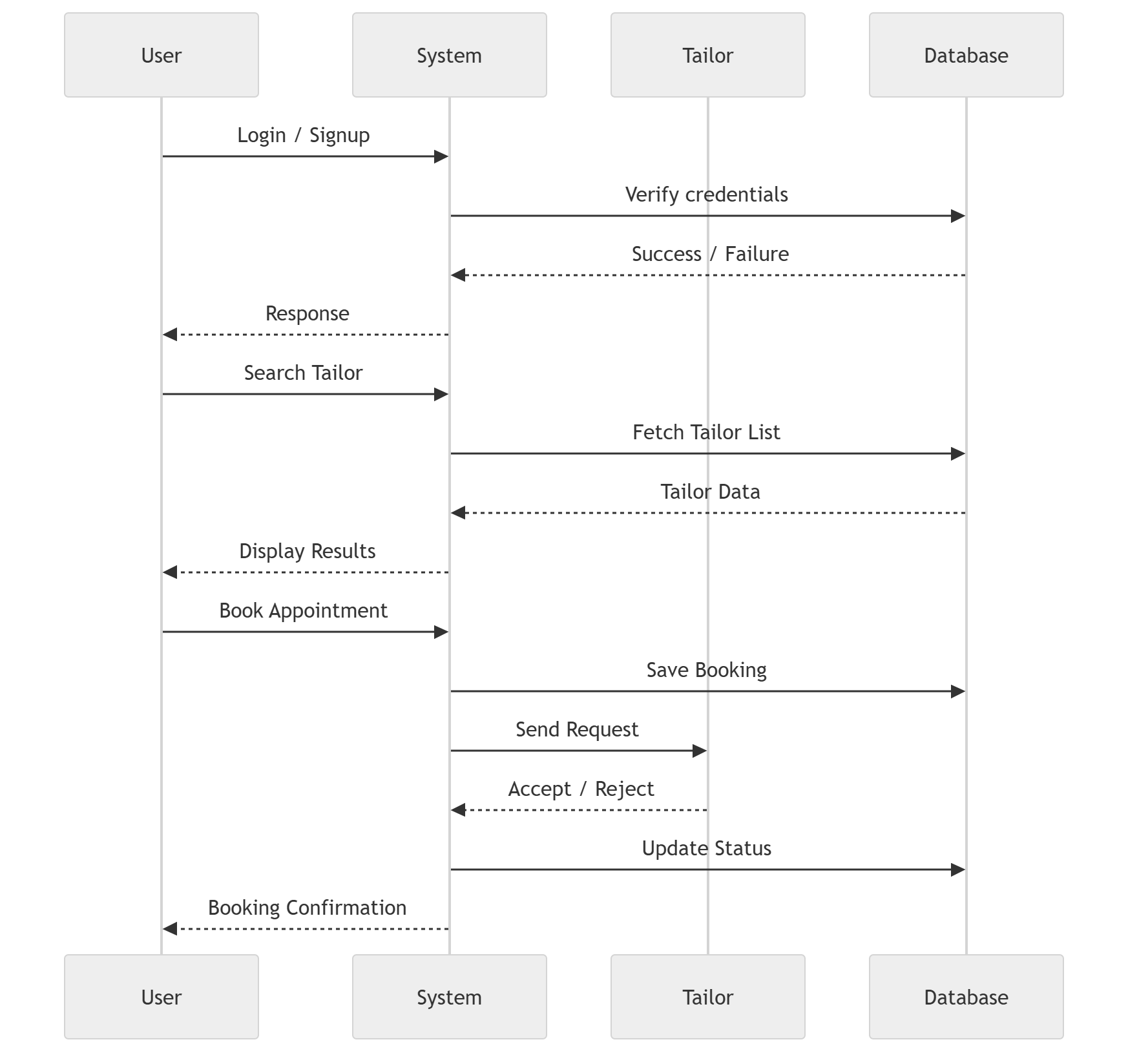
Sequence Diagram

Slide 9
Technology Stack
Frontend Technologies React.js
A JavaScript library used for building the user interface.
Provides a component-based architecture for reusable UI elements.
Ensures fast rendering using the virtual DOM.
Manages state efficiently with React Hooks (useState, useEffect).
Tailwind CSS
A utility-first CSS framework for rapid UI development.
Offers a highly customizable and responsive design without writing extensive CSS.
Ensures a modern and visually appealing user interface.
Backend Technologies Node.js
A runtime environment that enables server-side execution of JavaScript.
Handles multiple simultaneous requests efficiently using an asynchronous, non-blocking architecture.
Facilitates seamless integration between the frontend and backend using a single language (JavaScript).

Slide 10
Technology Stack
Express.js
A lightweight web framework for Node.js used to build RESTful APIs.
Simplifies backend development by providing robust routing and middleware support.
Ensures secure data handling and authentication processes.
Database Management MongoDB
A NoSQL database that stores data in a flexible JSON-like format.
Provides high scalability and performance for handling large volumes of healthcare data.
Uses collections to manage users, doctors, appointments, and payments efficiently.

Slide 11
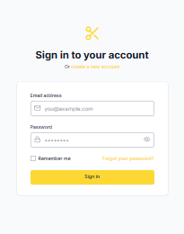
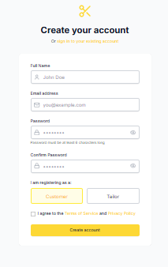
Login/Signup Page

Slide 12
Conclusion
The development of BookMyTailor aims to transform the way customers interact with tailoring services by providing an efficient and user-friendly digital platform. By leveraging modern web technologies like React.js, Tailwind CSS, Node.js, Express.js, and MongoDB, the system ensures a smooth, secure, and scalable experience. It enables users to easily find tailors, book appointments, and manage their customization needs in one place.
In conclusion, BookMyTailor successfully combines modern technologies to deliver a practical and accessible solution for both customers and tailoring professionals. With a focus on convenience, efficiency, and scalability, this project opens the door for future enhancements such as online payments, real-time tracking, and personalized recommendations, making it a valuable innovation in the field of digital service platforms.

Slide 13
Future Scope
Doorstep tailor service – Enable tailors to visit customers at home for measurements and fittings
Live tracking – Track tailor location in real time during home visits Online
payment integration – Support secure payments through UPI, cards, and wallets
Rating and review system – Allow users to rate and review tailors
Mobile application – Develop Android and iOS apps for better accessibility
Notifications and alerts – Provide booking confirmations, reminders, and updates
AI-based recommendations – Suggest designs and tailors based on user preferences
Multi-city expansion – Scale the platform to multiple locations

Slide 14
Thank You

